Slide 1
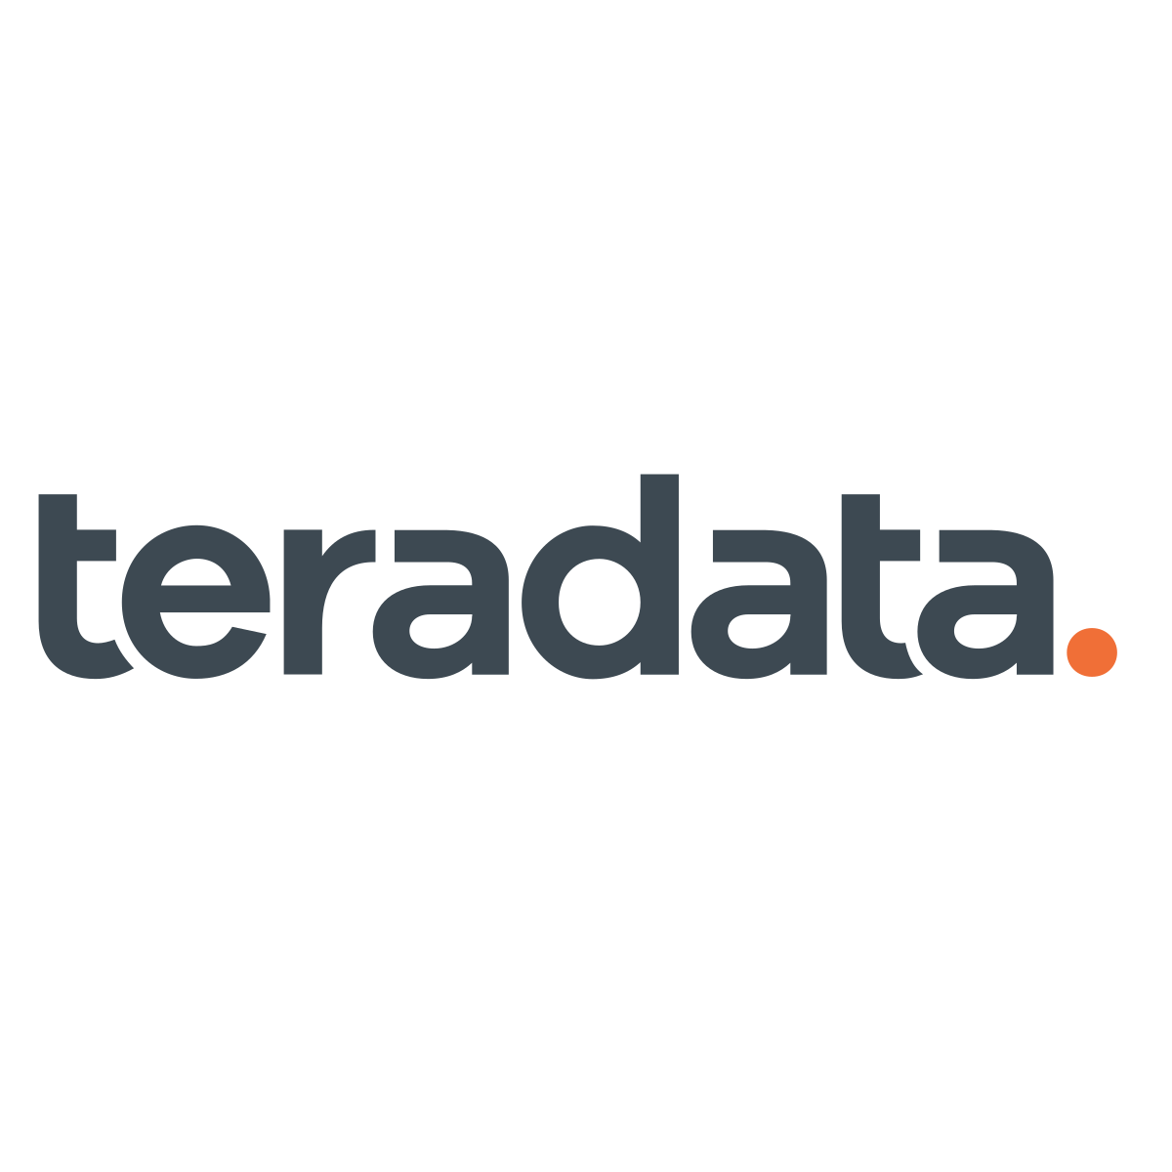

Slide 2
General company information
Teradata is an enterprise software company that develops and sells database analytics software subscriptions. The company provides three main services: business analytics, cloud products, and consulting.

Slide 3
Acquisitions
Terradata went public in 2008. Ever since then it has acquired:
Claraview (2008), a professional services company.
Kickfire (2010), a Database Management System vendor
Aprimo (2010), a marketing software company
Astar Data Systems (2011), a data management and analysis software company
eCircle (2012) an email direct marketing company
Revelytix (2014) information prodiver on management products
Think Big Analytics (2014), a Hadoop service company
RainStor (2014), a company specializing in online data archiving on Hadoop
Appoxxee (2015), a mobile marketing software
FLXone (2015), a digital marketing company
Big Data Partnership (2016), a service company
StackIQ (2017), maker of the Stacki software (a computer cluster software, basically a multiple computers viewed as one system)

Slide 4
Cluster computing quick overview
Their main utility is to improve performance and availability over that of a single computer, being more cost-effective than single computers of comparable speed or availability.
Computer clusters emerged as a result of a convergence of a number of computing trends including the availability of low-cost microprocessors, high-speed networks, and software for high-performance distributed computing. They have a wide range of applicability ranging from small business clusters with a handful of nodes to some of the fastest supercomputers in the world.

Slide 5

Teradata quick financials
2.1x
Ent. Val. / Revenue
2.1x
21.5x
Ent. Val. / EBITDA
21.5x
EBITDA / Eq. Value Multiple
15.6x
15.6x
9.09x
Price to Book
9.09x

Slide 6
Recent developments (DCF also on drive)
Teradata is transforming its current business model to a recurring revenue model, with a subscription-based billing
YoY comparisons might become meaningless in the short term
Payments and receivables might be delayed/moved forward
Safer
Drive software sales
“We are pleased that Teradata had a strong quarter with customers moving to subscription at a record rate, demonstrating our strategy in action,” said Vic Lund, Interim CEO, Teradata. “[...] we invested in an even stronger future for Teradata [...] moving toward in cloud, [...], and expanding our market reach.”
Q3 operating income was $43 million versus $56 million in the third quarter of 2018. The decrease in operating income was due to a higher subscription-based bookings mix which resulted in a significant decline in perpetual revenue, as well as a decline in consulting revenue consistent with our strategy.

Slide 7
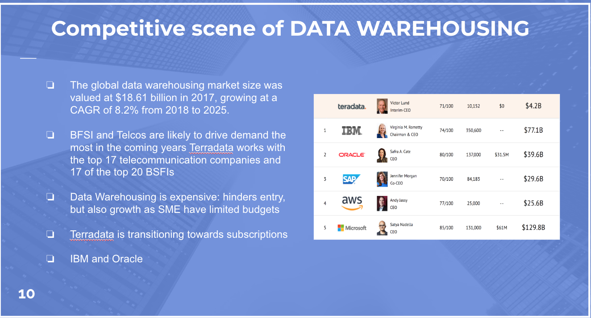

Slide 8
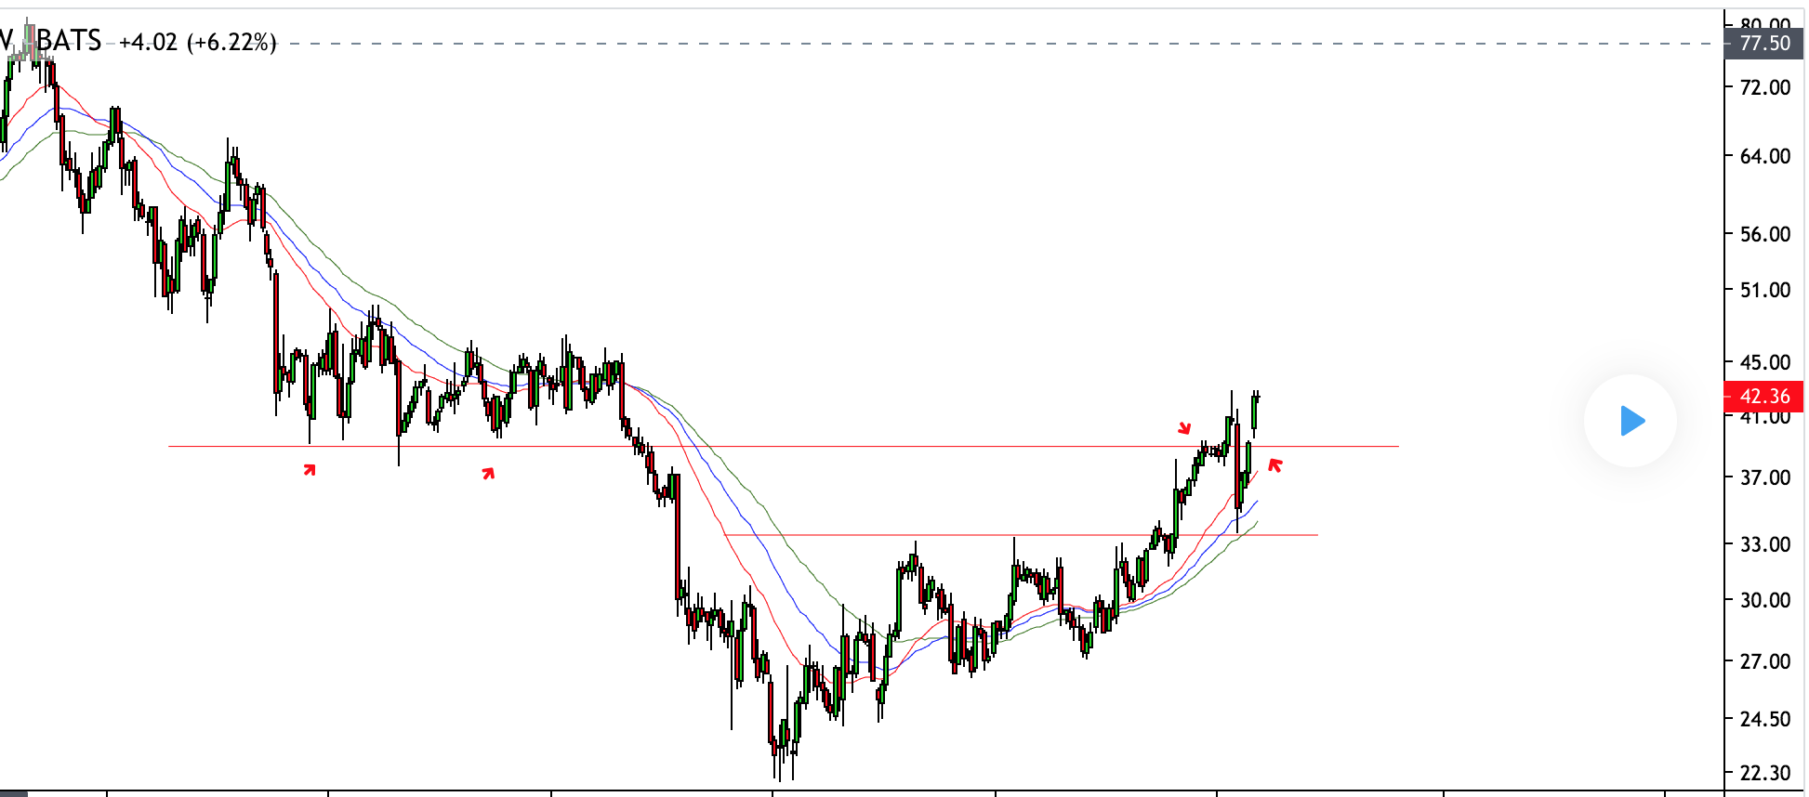

Slide 9
